Slide 1
Next-Level CX for B2B Companies

Slide 2
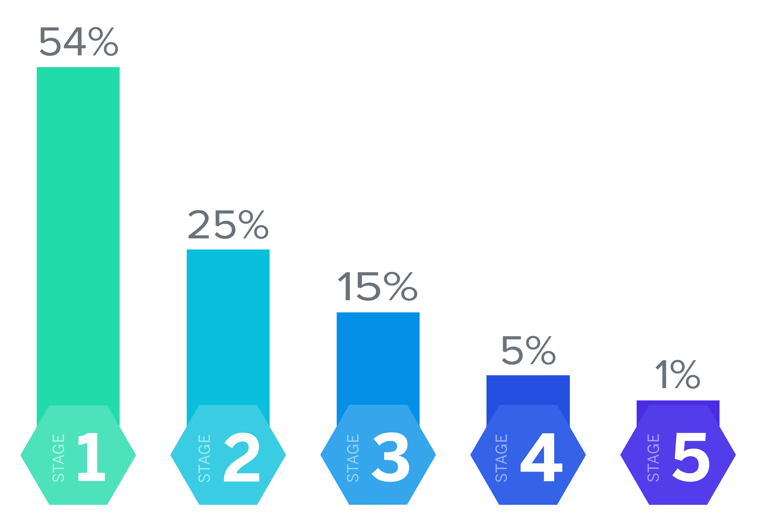
Maturity is low; the time to act is now
63%
of companies rated themselves as having “very weak” performance on the CX competencies
The vast majority of companies are in the bottom two stages of maturity

Slide 3
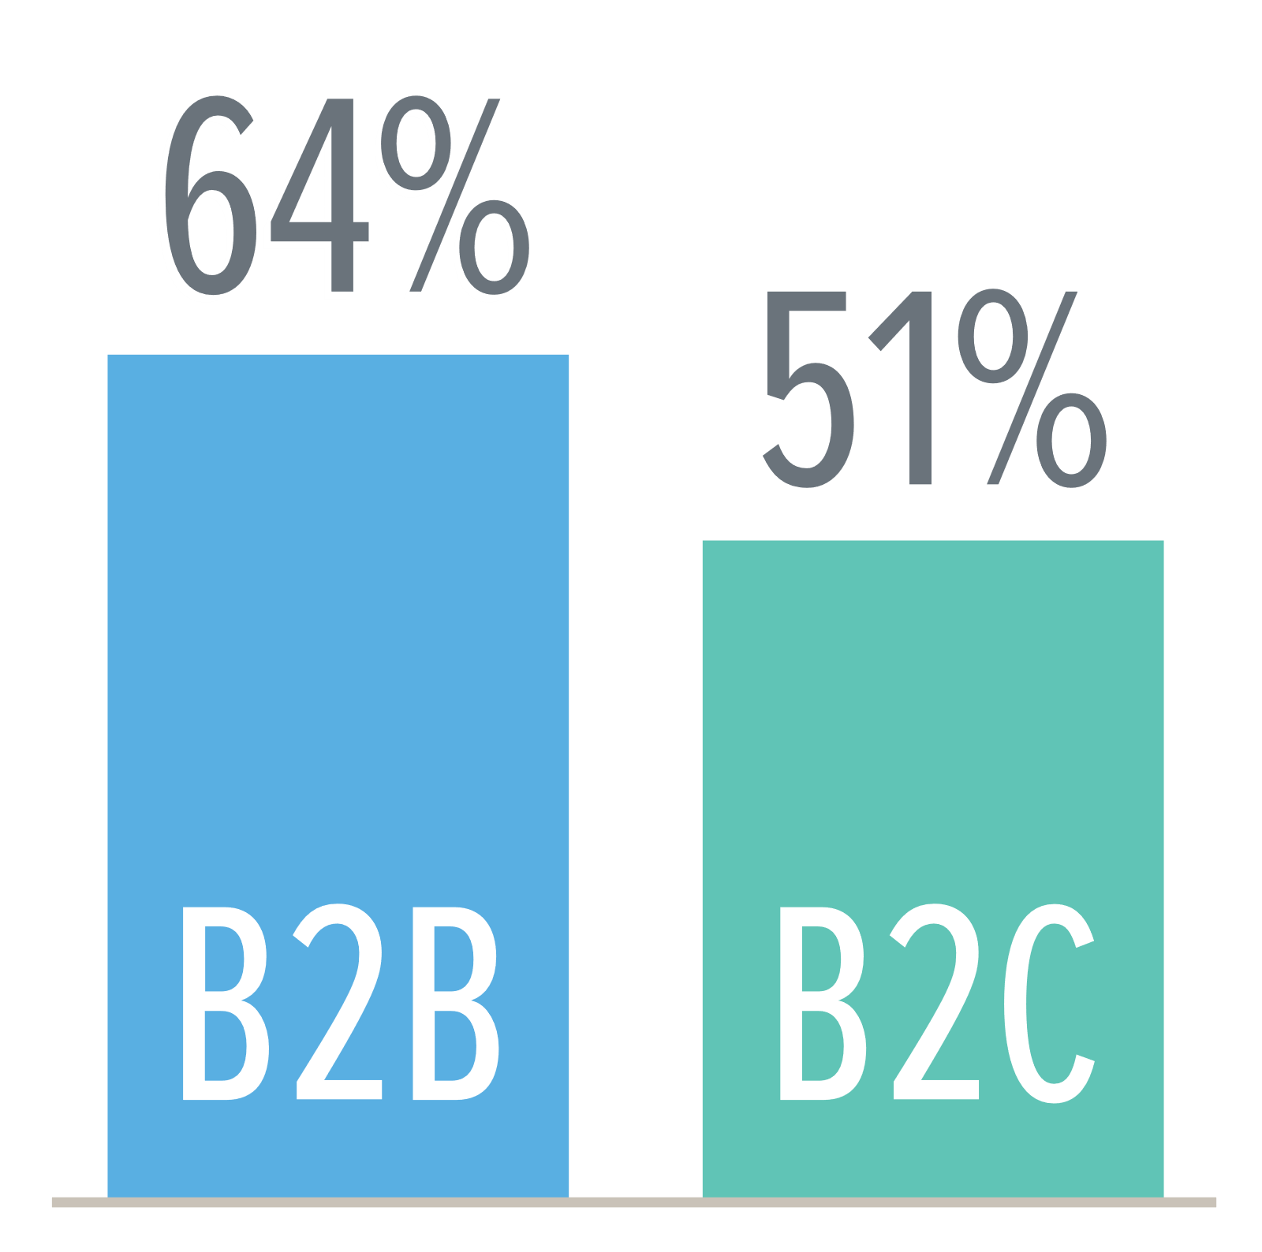
B23B vs B2C: There’s ground to make up
Nearly two-thirds of B2B companies are at the lowest stage of maturity (Investigate), meaning the organization is not focused on CX as a strategic opportunity.

Slide 4
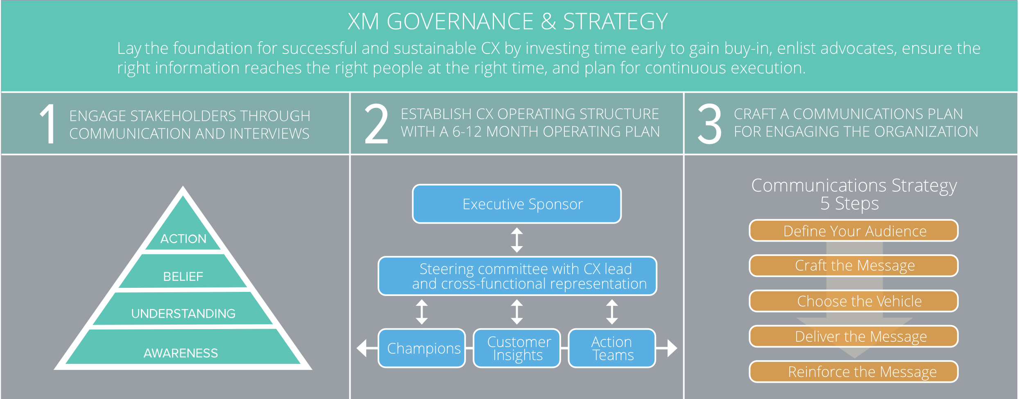
XM Governance and Strategy

Slide 5
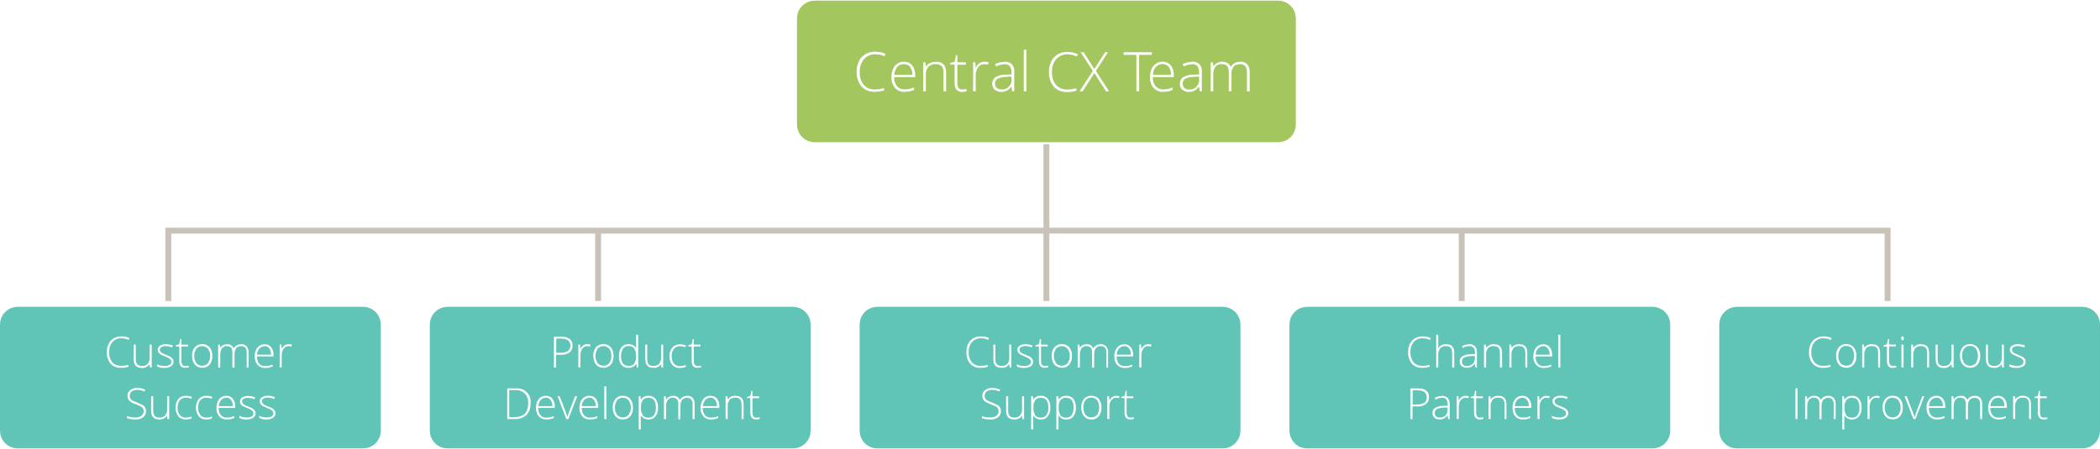
Federated Team Model Example

Slide 6
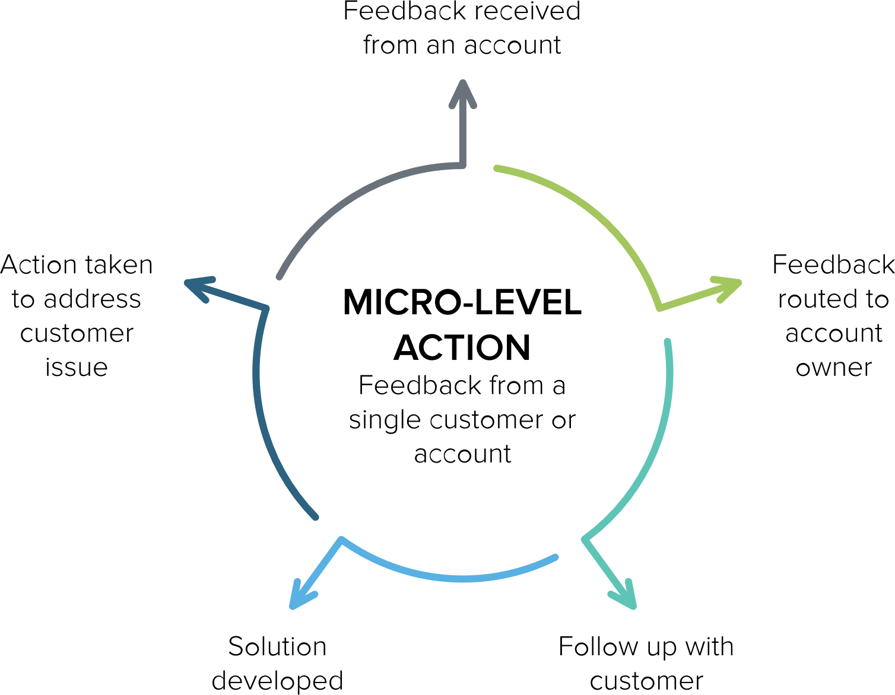
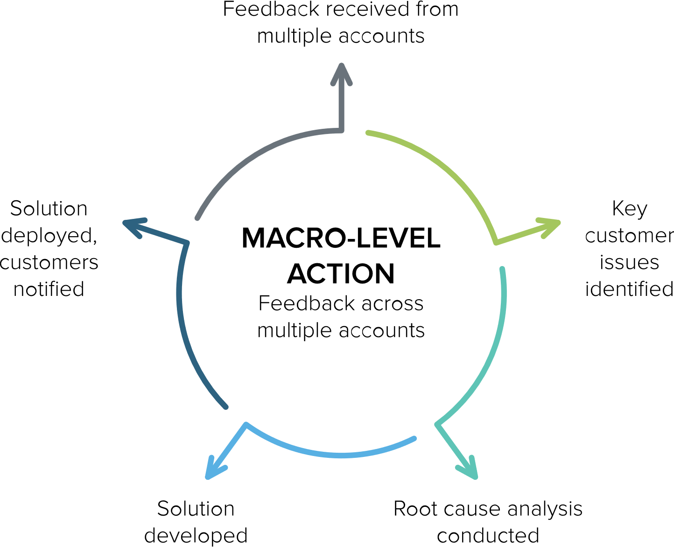
Micro and Macro – Closing the loop at multiple levels
Just starting out with CX? Think of it as an exercise in fixing micro experiences. A customer complains, and you find an effective way to resolve it.
Ready for Next-Level CX? Turn your focus to addressing ineffective processes at a macro level.

Slide 7
Companies are investing, but the gap still remains
95%
are adequately investing in digital experience
82%
have undergone a digital transformation
71%
still have a customer-centricity gap
A recent study by Episerver found that 95% of B2B companies believe their company is adequately investing in improving the digital experience it delivers online and 82% of them claim they have undergone a digital transformation project. Of those that have taken on such a project, nearly all of them (97%) considered it to be successful. And yet, 71% of overall respondents claimed their company has a customer-centricity gap, meaning the digital experience they offer does not meet the needs and expectations of their customers.
SOURCE: B2B Digital Experience Report: A Customer-Centric Pivot in Pivotal Times, published in 2020 by Episerver

Slide 8

Digital Mapping Methods
CX leaders need to embrace user experience (UX) methods to design and improve digital experiences.
Persona Creation Develop profiles of customer types to better understand their needs and deliver the experience they want.
Empathy Mapping
Map the emotional ups and downs that your customers experience.
Scenario Mapping
Chart common scenarios (aka, stories) that show how your customers interact with your digital tools to achieve an objective.
Digital Journey Mapping
Chart the digital path your customers take as they work with you.
Service Blueprinting
Map the interaction of people, systems, and processes for specific touchpoints in the customer journey.

Slide 9
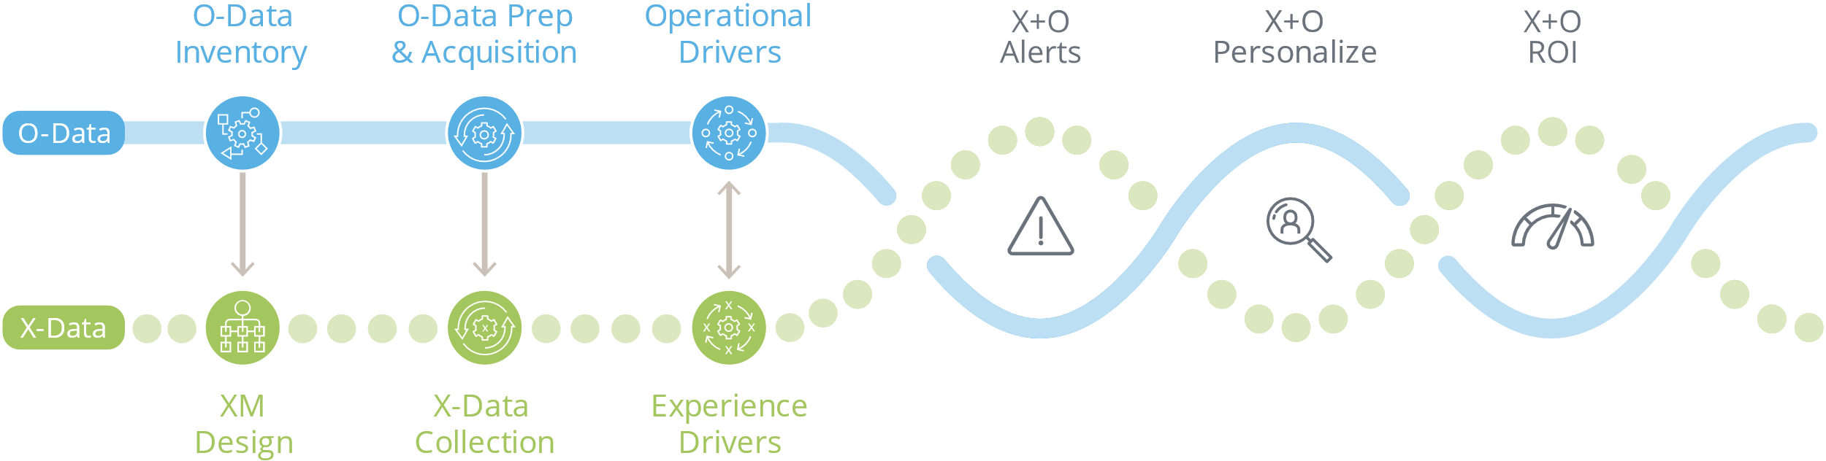
X+O Roadmap
X-data is used to validate the correct use of O-data.
O-data is brought in as
X-data is collected.
Current O-data informs what we collect from customers.
Using X+O data to provide action alerts to the organization ​
Use X-Data to set O-data thresholds
Alerting when O-Data predicts a poor experience or potential risk/ opportunity
Using X+O data to personalize the customer experience ​
Persona development​
Prescriptive analytics:
what is the next best action/intervention
Time series analysis:
How changing perceptions relate to behaviors (at customer level, or in aggregate)​
Forecasting/realizing impact of improvements
Companies start by taking inventory of their commonly used operational data and use that to inform the design of their XM program
Operational data is then prepared, acquired and integrated as experience data is collected
Companies then validate the O-data measurements they are using are consistent with X-data feedback which indicates what companies really want.
If O-data measures need adjustment, X-data guides the establishment of the right measures at the right levels

