Slide 1



Walker is a Qualtrics certified full-service Experience Management (XM) firm.
FULL SERVICE
End-to-end managed services
QUALIFIED
Qualtrics & XM certified consultants
We believe everyone deserves an amazing experience. Our team of experts provides technology implementation, end-to-end managed services, and expert strategic consulting – all to deliver better results for our clients.
TRUSTED
#1 North American Partner
SPECIALIZED
30+ years in CX and EX
1,500+
Qualtrics engagements
95%
CSAT
EXPERIENCED
80 years serving clients
Exclusive partner to Qualtrics • Largest service delivery partner in North America • 2019 Partner of the Year
1
^{st}
1
^{st}
1
^{st}
60+
QPN
Charter member
XM Solution
One of the first partners to develop an XM solution
Advisory Solutions
One of four selected to deliver
new advisory solutions
Certifications
CX/EX/Research Core

Slide 2
Approaches tailored to client needs and maturity
Light-touch - Using in-house resources
High-touch - Using external resources
STANDARD
GUIDED
ADVANCED
MANAGED XM
Starts at $7,500
Starts at $20,000
Starts at $50,000
Starts at $100,000
Show me what to do
Build it with me
Build it for me
Run it with me
Support to get you up and running on Qualtrics technology
Delivery of XM programs that empower you to take action
Prescriptive consulting to reshape your XM approach, deliver high value insights, and drive ongoing value
Dedicated experts to establish, innovate and operate XM programs across your organization
Qualtrics Platform Training
One Basic Use Case
Client Builds
Qualtrics Platform Training
Lite Advisory Support
Walker Builds
Lite Ongoing Support
Qualtrics Platform Training
In-Depth Advisory Support
Walker Builds
Heavy Ongoing Support
Large, Complex Engagements
Extensive Technology
Requirements
Extensive Services Needed
MOST POPULAR PACKAGES

Slide 3
Walker’s End-to-End Services
PROGRAM DEPLOYMENT
ONGOING SUCCESS
Strategy & Design
Program Advisory
Program Execution
Implementation
GUIDED – Build it with me
Delivery of XM programs that empower your organization to take action
FULL SERVICE
ADVANCED – Build it for me
Prescriptive consulting and delivery to reshape your organization’s approach to XM and ensure continued value realization
PROJECT BASED
TECHNOLOGY SERVICES
ADVISORY SERVICES
EXECUTION SUPPORT
Notes:
Can we embedded/link this slide into slide 4 –About Walker Slide. Trying to reduce # of slides/pages

Slide 4





Walker’s Advisory Services
Survey Design
Ensure your organization is using a reliable CX measurement tool to collect the right insights, from the right customers, at the right time, using the most appropriate medium.
XM Governance
& Strategy
Lay the foundation for successful and sustainable XM by investing time early to gain buy-in and enlist early advocates. Build the right team to ensure the right information reaches the right people at the right time and plan for continuous execution.
Program Design
Design an effective CX program that ensures your organization is setup for success once feedback starts coming, resulting in faster insights, actions, and ROI.
Journey Mapping
What moments have the biggest impact on your customers’ experience, and how do you perform relative to expectations? Align the organization around a common and shared view of the customer experience.
Listening Architecture
Align customer listening activities into an intelligent and effective system that drives actionable CX insights, action and change.
More info
More info
More info
More info
More info
Notes:
Love this, the slides these can link to are at the bottom of this deck.

Slide 5
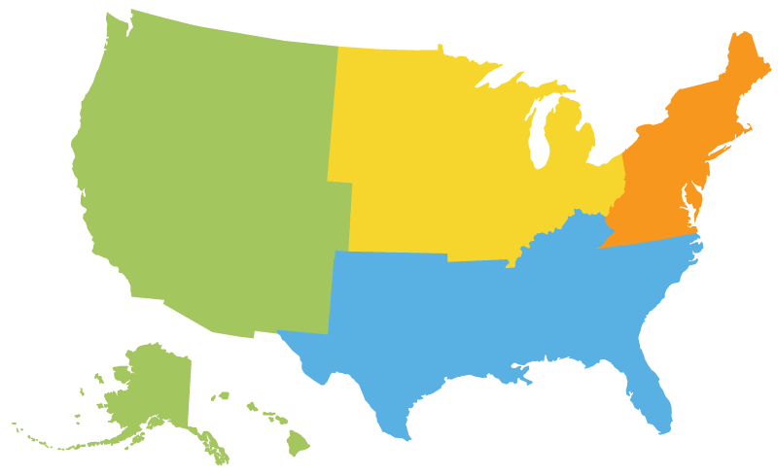

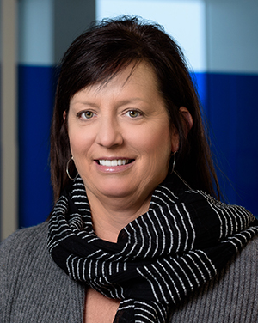
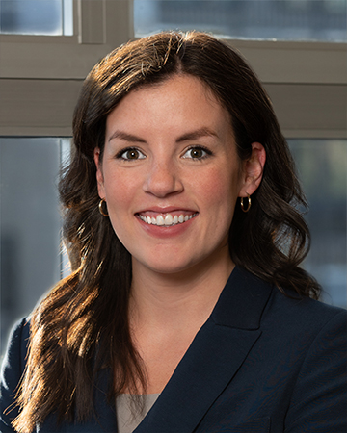

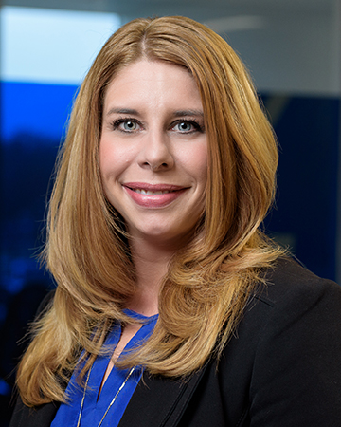




AE Alignment
WEST
ENTERPRISE
Sonya McAllister
smcallister@walkerinfo.com
CANADA
MIDMARKET
Sara Walker
sarawalker@walkerinfo.com
ENTERPRISE
Lauri Jones
ljones@walkerinfo.com
CENTRAL
CENTRAL
NORTHEAST
HEALTHCARE
AND REGULATED INDUSTRIES
ENTERPRISE
Katie Kiernan
kkiernan@walkerinfo.com
ENTERPRISE
Katie Kiernan
kkiernan@walkerinfo.com
ENTERPRISE
Lauri Jones
ljones@walkerinfo.com
MIDMARKET
Jamieson Prala
jprala@walkerinfo.com
Chris Woolard
cwoolard@walkerinfo.com
MIDMARKET
Courtney Adkins
cadkins@walkerinfo.com
MIDMARKET
Hannah Henry
hhenry@walkerinfo.com

